Slide 1

Knight Market
by BASSH
Seongrim Choi
Oghenesuwe Ogedegbe
Benedicto Elpidius
Heonjae Kwon
Antonio Sepulveda

Slide 2
Vision

Slide 3
DEMO TIME

Slide 4
User Stories

Slide 5
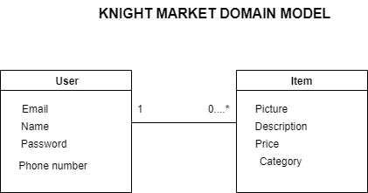

Slide 6
Database

Slide 7
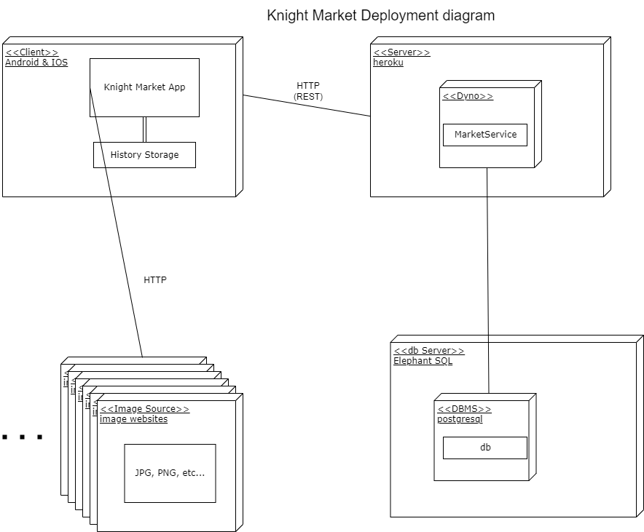

Slide 8
Technology is a Trade Off

Slide 9
QUESTIONS

Slide 10
THANK
YOU!

